Slide 1

DEPARTMENT OF COMPUTER SCIENCE AND ENGINEERING CMR TECHNICAL CAMPUS UGC AUTONOMOUS Kandlakoya,Medchal Road, Hyderabad - 501 401
RESOLGATE: An AI-Assisted Approval-Based Knowledge Repository for Education and Rural Learning
Under Guidance of:
Bhagyashree B.M
PRESENTED BY:
V. Abhilash Chary 237R1A05Y6
Sabavat Rahul 247R5A0529
Bandi Bhavitha 247R5A0526

Slide 2
INTRODUCTION
Digital platforms are widely used for storing and sharing educational resources.
Traditional cloud storage systems mainly focus on file storage and collaboration.
However, these platforms lack intelligent mechanisms to detect harmful or inappropriate content
AI technologies can improve content monitoring and security in file sharing systems.
ResolGate is designed as an AI-assisted knowledge repository for secure file sharing and moderation.

Slide 3
PROBLEM STATEMENT
Existing cloud storage systems face several challenges when used in educational environments.
Lack of intelligent content moderation for uploaded files.
Files become instantly accessible without proper review.
Password-based authentication introduces security vulnerabilities.
Limited access control and permission management.
Insufficient audit logs for monitoring file activity.

Slide 4
OBJECTIVES
Develop a secure and scalable file management system.
Implement AI-based content moderation for uploaded files.
Design a multi-stage approval workflow before publishing content.
Provide role-based access control for secure file sharing.
Maintain detailed audit logs for monitoring system activity.

Slide 5
EXISTING SOLUTIONS
Cloud platforms such as Google Drive, Dropbox, and SharePoint provide file storage and collaboration features.
These platforms focus mainly on accessibility and file sharing.
However, they lack intelligent mechanisms for detecting harmful or inappropriate content.
Most systems do not include AI moderation or advanced approval workflows.

Slide 6
DRAWBACKS
Lack of AI-based content moderation to detect harmful content.
Files become accessible without proper approval or review.
Password-based authentication can lead to security risks.
Limited audit logging and monitoring of file activities.
Insufficient content control mechanisms for organizations.

Slide 7
LITERATURE SURVEY
Research studies focus on cloud storage systems and AI-based content moderation.
Traditional platforms provide storage and collaboration features. Recent research emphasizes AI techniques for detecting harmful content.
Modern systems integrate automated moderation and approval workflows for improved security.

Slide 8
PROPOSED SOLUTION
ResolGate provides a secure knowledge repository with AI-assisted moderation.
Users upload files which are temporarily stored for analysis.
AI models analyze the content and generate safety scores. Administrators review flagged content through an approval dashboard.
Approved files are then published and shared securely.

Slide 9
SYSTEM ARCHITECTURE & WORKFLOW
User Upload ⬇ Temporary Storage ⬇ AI Moderation ⬇ Admin Approval ⬇ File Publication

Slide 10
ADVANTAGES
AI-based moderation improves content safety.
Approval workflows prevent unauthorized content publishing.
Passwordless authentication enhances security.
Serverless architecture ensures scalability and performance.
Open-source design reduces operational cost.

Slide 11
TOOLS AND TECHNOLOGIES
Programming Languages TypeScript, JavaScript
Frameworks / Libraries React, Tailwind CSS
Backend & Database Supabase, PostgreSQL
Deployment Platform Vercel
AI Model Gemini AI

Slide 12
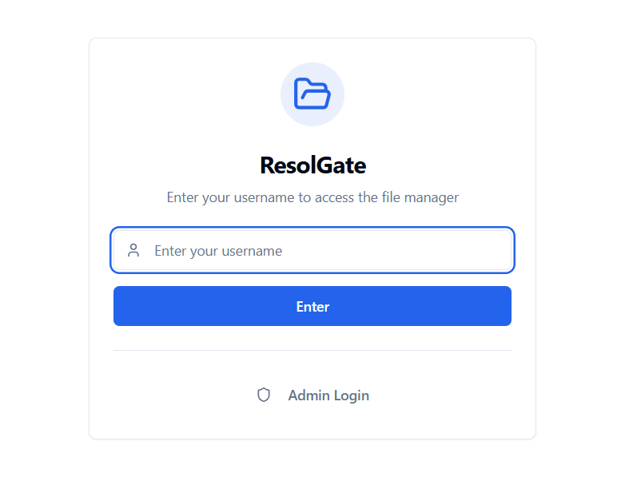
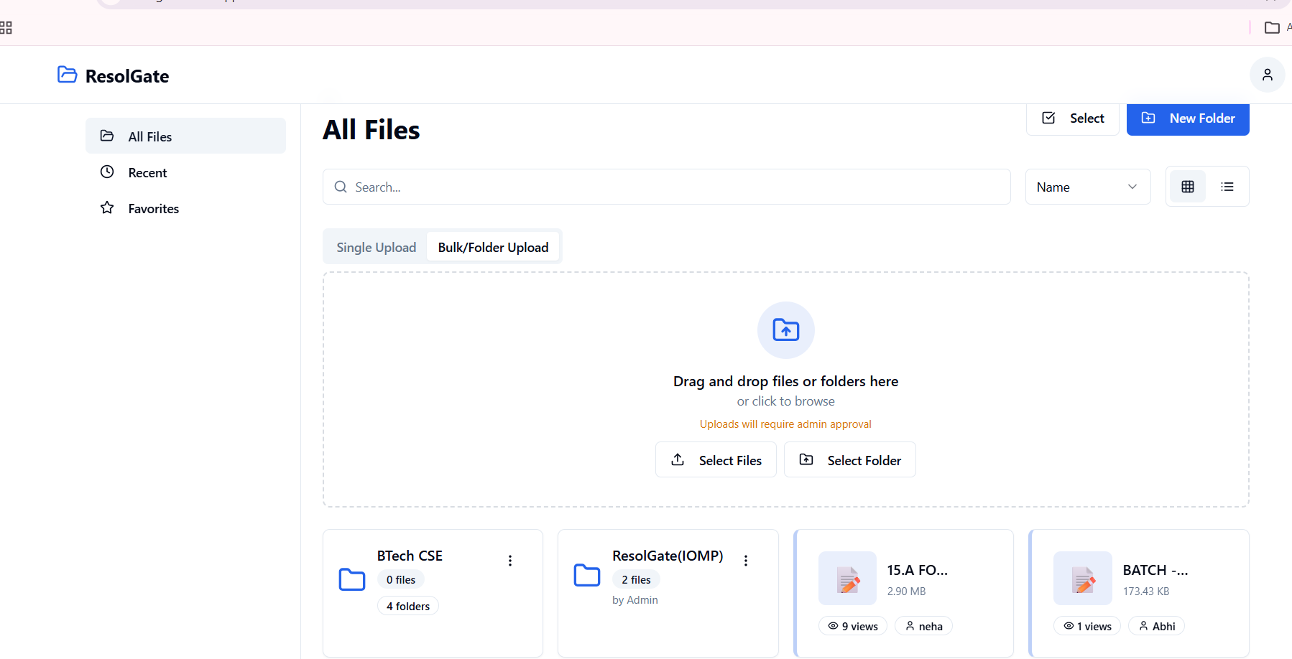
RESULTS

Slide 13
CONCLUSION
ResolGate provides a secure and scalable AI-assisted file management system.
The platform combines AI moderation with human approval workflows.
It improves security, reliability, and compliance in digital content sharing.
Overall, the system enables safe and efficient knowledge sharing in educational environments.

Slide 14
FUTURE ENHANCEMENT
Improve AI models for more accurate content moderation.
Add advanced search and file preview features.
Implement multi-factor authentication for better security.
Enable collaborative editing and version control for files.
Integrate with third-party platforms for better accessibility.

Slide 15
REFERENCES
React Official Documentation.
Supabase Documentation for PostgreSQL and Authentication.
Vercel Cloud Deployment Documentation.
Google DeepMind – Gemini AI Technical Documentation.
Research papers related to AI-based content moderation and file management systems.

Slide 16
THANK YOU

